Slide 1
GoodReads Book Reviews
Group 1
IST 707
Allison Annick, Sara Cliffel, Kevin Hager, Sahil Nanavaty, Sana Khan, Victoria Shu

Slide 2
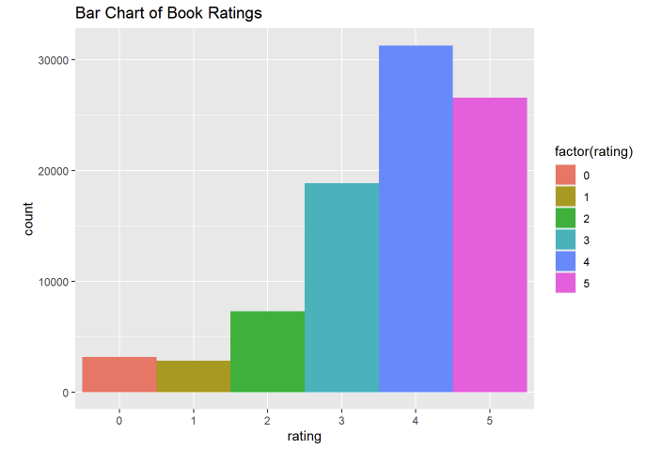
Data Mining Problem
Demonstrate the importance of text-based book reviews.
Demonstrate the difficulties of using a 1-5 rating scale, the number of comments, and the number of votes to predict the quality of a book.

Slide 3
Data Set
1.3 Million Rows with the following attributes
user_id - Id of user
book_id - Id of Book
review_id - Id of review
rating - rating from 0 to 5
review_text - review text
date_added - date added
date_updated - date updated
read_at - read at
started_at - started at
n_votes - no. of votes
n_comments - no. of comment
Guiding Questions
Are ratings, votes, and comment numbers an effective way to communicate the quality of a book?
Is the user who is authoring the review and rating important to the understanding of the overall book review?
Can text-based reviews offer a medium in which to more effectively communicate the quality of a book?

Slide 4
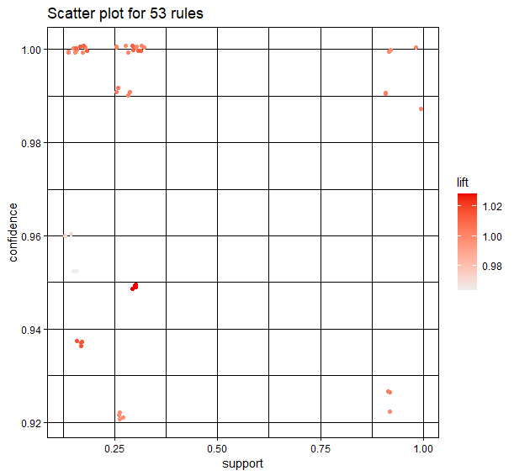
Association Rule Mining
[1] {rating=2} => {n_comments=between 0 and 3}
[2] {rating=3} => {n_comments=between 0 and 3}
[3] {rating=5} => {n_comments=between 0 and 3}
[4] {rating=4} => {n_comments=between 0 and 3}
[5] {rating=3} => {n_votes=between 0 and 10}
[6] {rating=5} => {n_votes=between 0 and 10}
[7] {rating=2} => {n_votes=between 0 and 10}
[8] {rating=4} => {n_votes=between 0 and 10}
[9] {rating=2, n_comments=between 0 and 3} => {n_votes=between 0 and 10}
[10] {rating=4, n_comments=between 0 and 3} => {n_votes=between 0 and 10}
[11] {rating=5, n_comments=between 0 and 3} => {n_votes=between 0 and 10}
[12] {rating=3, n_comments=between 0 and 3} => {n_votes=between 0 and 10}
[13] {rating=2, n_votes=between 0 and 10} => {n_comments=between 0 and 3}
[14] {rating=3, n_votes=between 0 and 10} => {n_comments=between 0 and 3}
[15] {rating=5, n_votes=between 0 and 10} => {n_comments=between 0 and 3}
[16] {rating=4, n_votes=between 0 and 10} => {n_comments=between 0 and 3}
[17] {n_comments=between 0 and 3} => {n_votes=between 0 and 10}
[18] {n_votes=between 0 and 10} => {n_comments=between 0 and 3}
a demonstration of the similarity between the 18 rules
Notes:
The graph created from the rules is a demonstration of the similarity between the 18 rules. The viewer can see all the data points are grouped together which is indicative of the minimal variation in the rules.
The similarity in the set of 18 rules generated above is reflective of the small range in the ratings, comments, and votes sections of the data. The votes ranged from 0 to 3222 votes. However, after binning the vote numbers, 845448 reviews fell into the “0-10 votes” bin. The comments ranged from 0 to 1335 comments. Similarly, after binning the comment numbers, 840609 reviews fell into the “0-3 comments” bin. Because there is so little variation in the majority of the data, the 1-5 rating system is responsible for differentiating between the book reviews. However, the 1-5 rating system offers only 5 separate bins in which over 900,000 book reviews must be classified. This does not offer enough variation to truly distinguish between quality books and inferior books.
Revisiting the guiding questions referenced above, the rules generated for this project would argue that ratings, votes, and comment numbers are not an effective way to communicate the quality of a book due to the inadequate range of the distinguishing variables. The lack of inclusion of any user IDs or book IDs in the generated rules indicates that there is not enough consistency in the rating of any user or book to warrant a rule. As such, the conclusion can be drawn that the user authoring the rule is not essential to understanding the review.

Slide 5
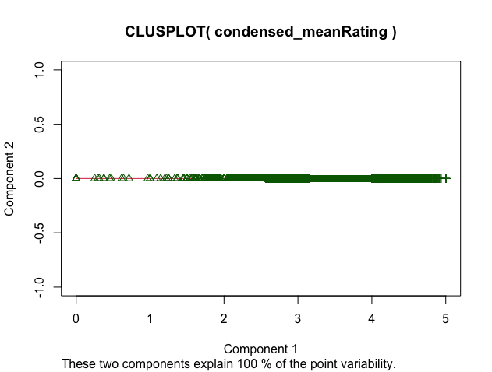
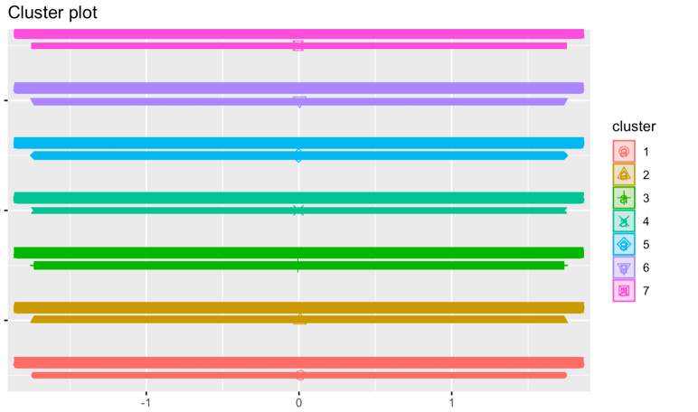
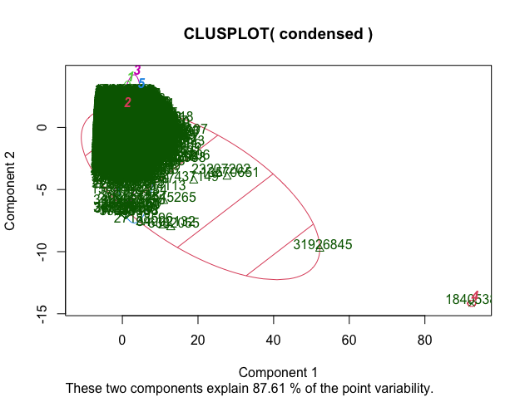
Clustering

Slide 6
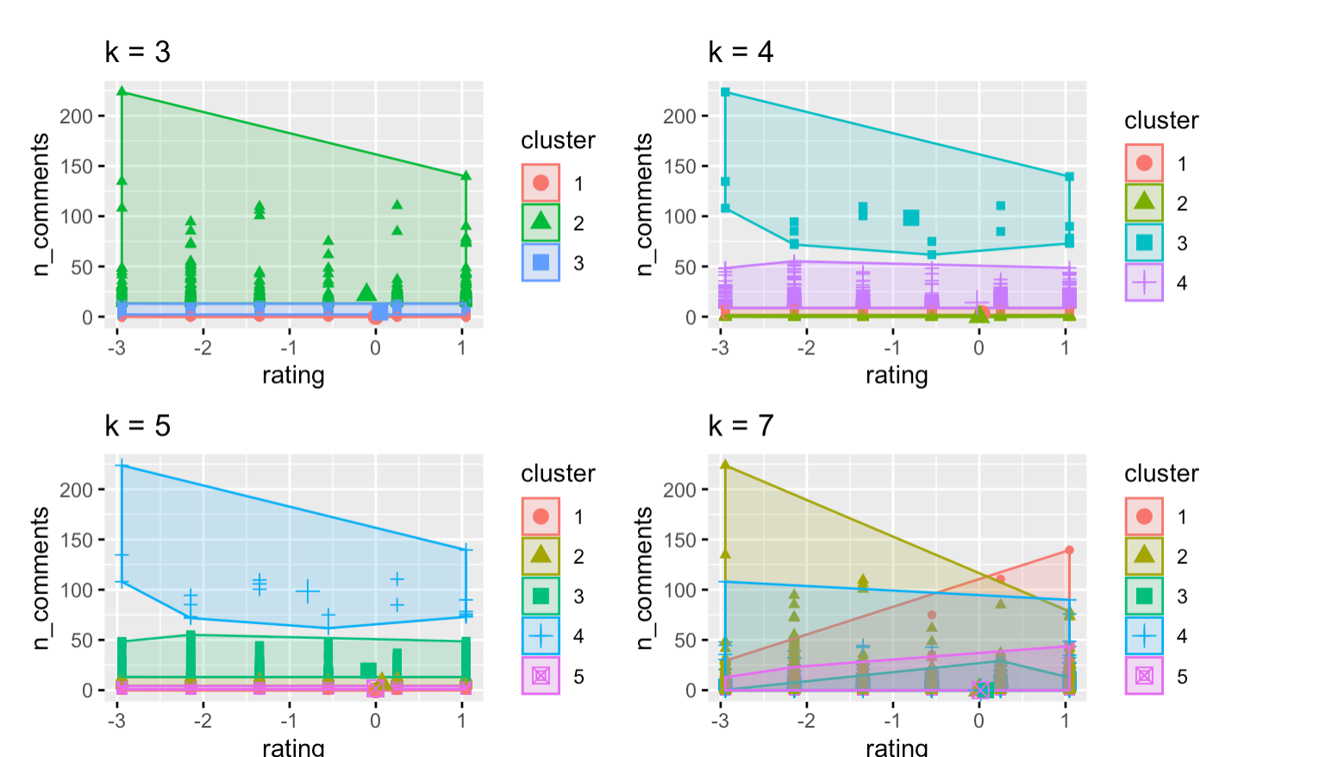
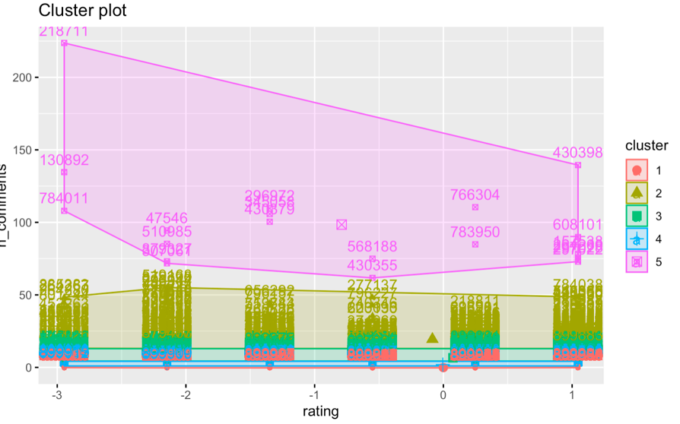
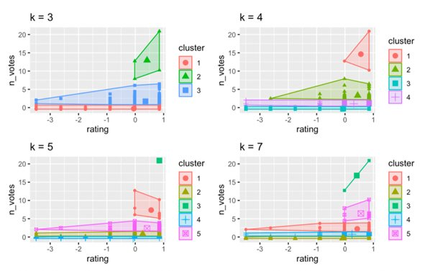
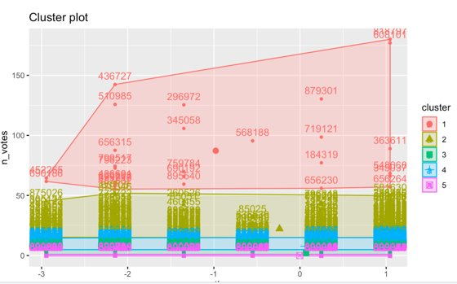
Clustering

Slide 7
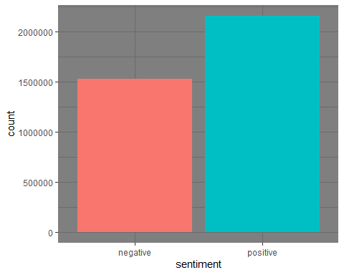
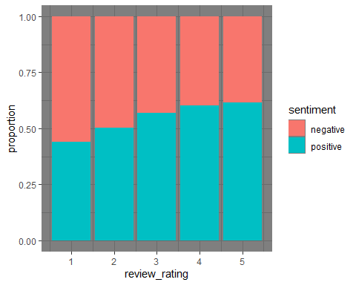
Sentiment Analysis Using Bing Lexicon

Slide 8
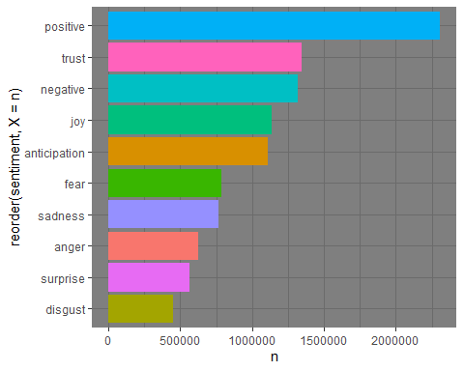
Sentiment Analysis using NRC Lexicon

Slide 9
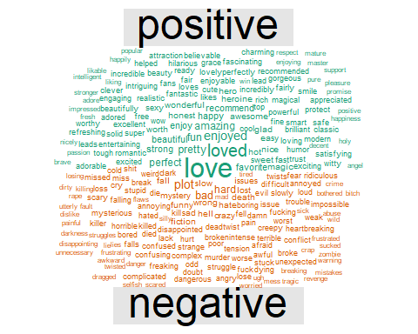
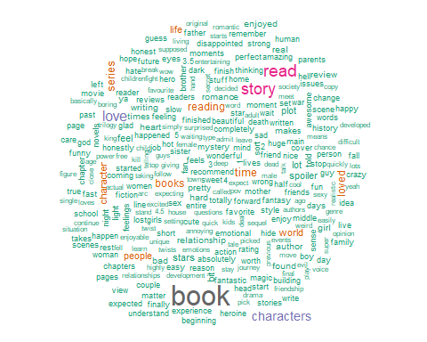
Word Clouds

Slide 10
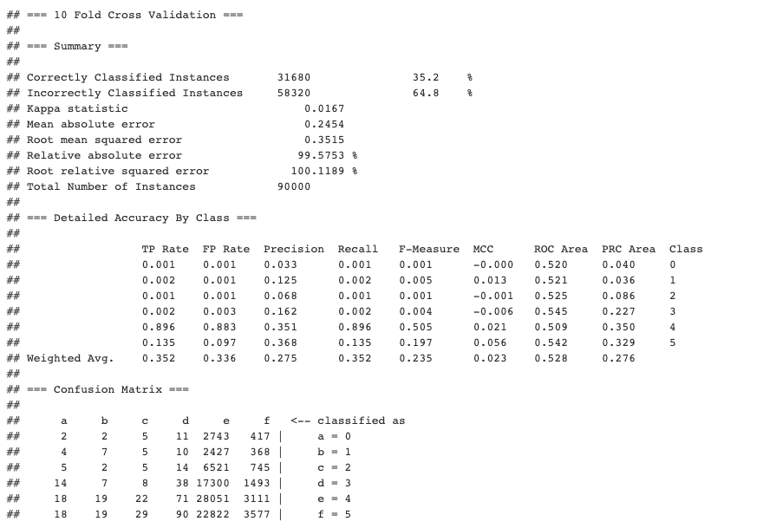
Decision Tree

Slide 11
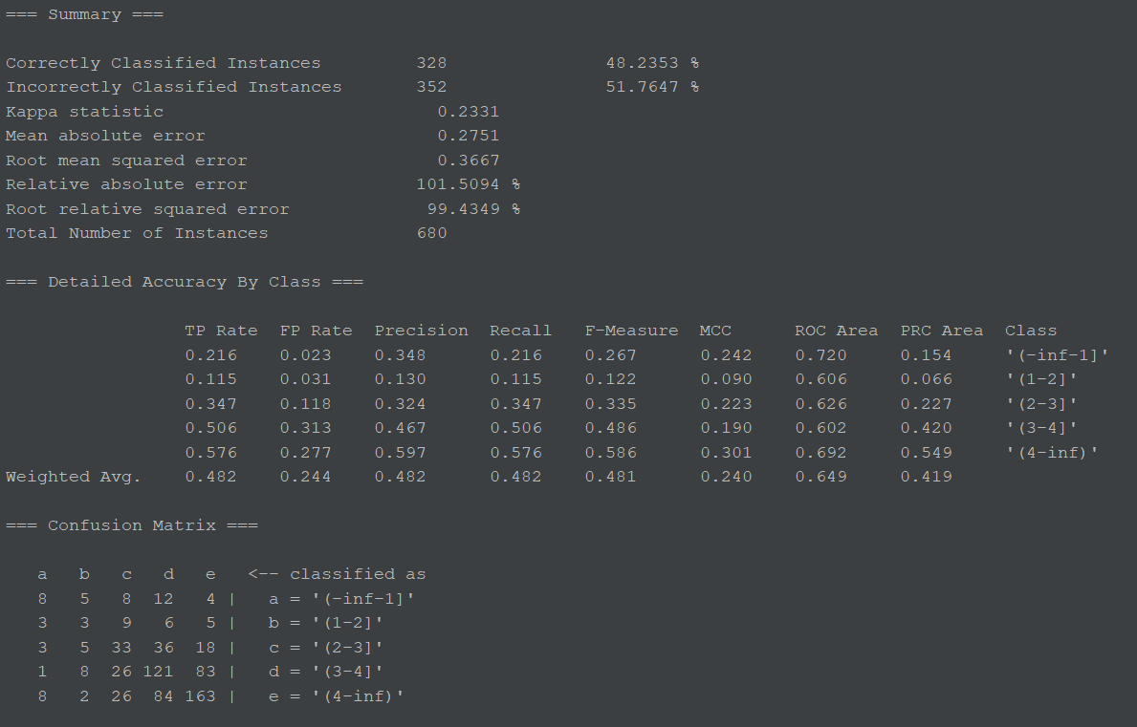
Text Categorization

Slide 12
Additional Attributes
Author
Genre
Book Titles
Age Demographic (Baby, Child, Pre-Teen, Young Adult, Adult)
Book Price
Type of Review (Critic vs User)
Number of pages
Notes:
Critiques on dataset.
with additional attributes, could have performed a more comprehensive analysis using the same techniques displayed in report
Some attributes: author, genre, book titles

